Slide 1
Creating and Managing Site Collections
Notes:
This module explains how SharePoint sites are provisioned with respect to site collections, Web Applications and content databases. You will see how to create new sites using site templates included with SharePoint Foundation and SharePoint Server 2010 including Team site, Publishing site and Enterprise Wiki. The module discusses customizing sites through the browser by adding site elements such as pages, Web Parts, lists and content types. There will also be a discussion of site customization using the SharePoint Designer 2010 and configuring SharePoint Designer Settings to restrict SharePoint Designer access. The module concludes with a discussion of governance and capacity planning to manage the growth of content across site collections and content databases.

Slide 2
Agenda
Understanding the User Interface
Working with Navigation
Working with Lists & Libraries
Working with Views, Pages & Web Parts
Governance

Slide 3
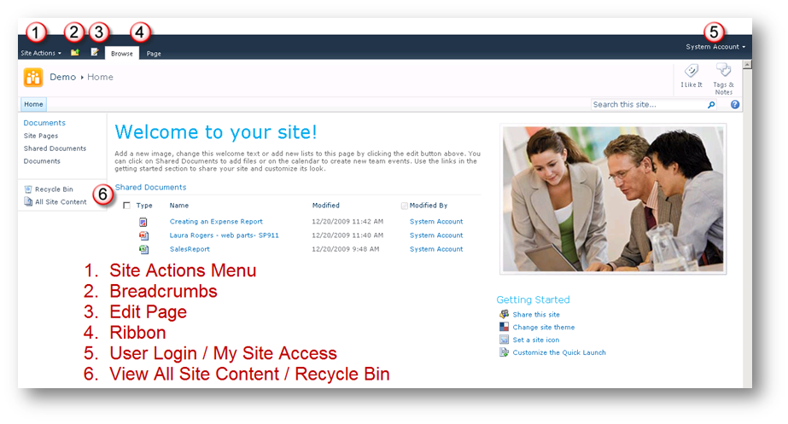
Where to find things?

Slide 4
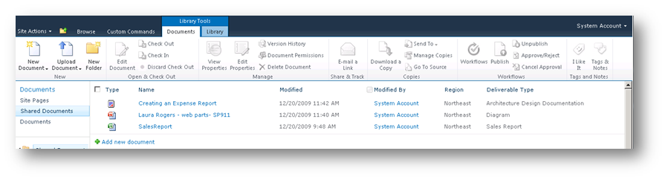
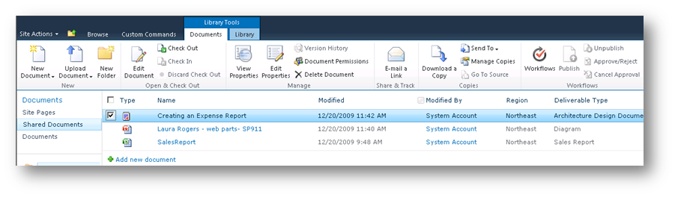
Fluent UI aka – Ribbon
Similar to Office Clients
Available Commands Based on Location in Site
Notes:
The Ribbon UI was a command interfaceintroduced in back in Office 2007.
The top-level elements are tabs, which organizes a set of group. Groups contains a set of controls which each control being tied to a unique command.
Contextual in nature, the ribbon UI will disable options and actions that do not apply to the selection or object the user is interacting with.
The UI is also extendable, allowing for developers to create customize solutions.

Slide 5
DEMO
Site Layout & Ribbon

Slide 6
Agenda
Understanding the User Interface
Working with Navigation
Working with Lists & Libraries
Working with Views, Pages & Web Parts
Governance

Slide 7
Site Navigation
Quick Launch
Top Navigation
Publishing vs. Collaboration – different options available for configuration
Notes:
Quick Launch: highlights what is on the current site
Top Navigation: links to pages that is on the current site or child sites that sit one level below in the site hierarchy.
Both navigational controls are completely customizable allowing site administrators to link to arbitrary external site (e.g. Bing.com)

Slide 8
DEMO
Modifying Site Navigation

Slide 9
Agenda
Understanding the User Interface
Working with Navigation
Working with Lists & Libraries
Working with Views, Pages & Web Parts
Governance

Slide 10
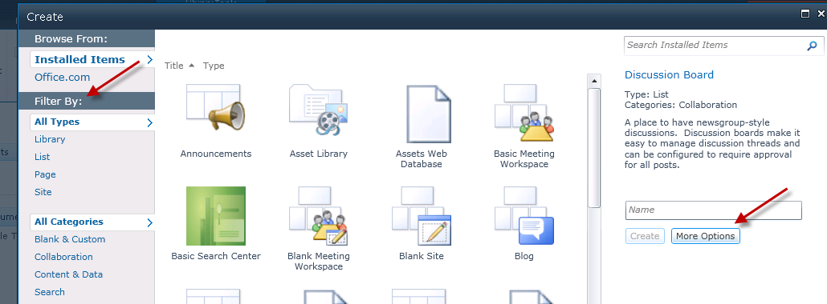
Creating New Content
Creation Screen
“Filter” Options
More Options
Notes:
Note: This screen is available if Silverlight is installed. If not, the “Classic” HTML creation screen will be displayed.

Slide 11
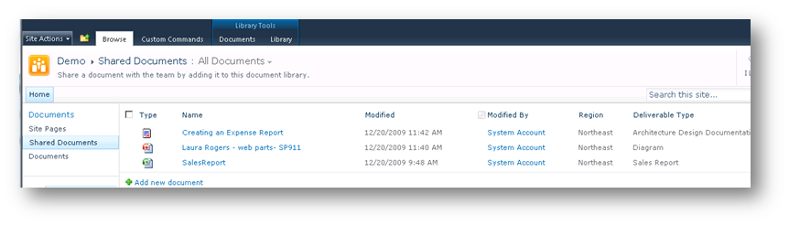
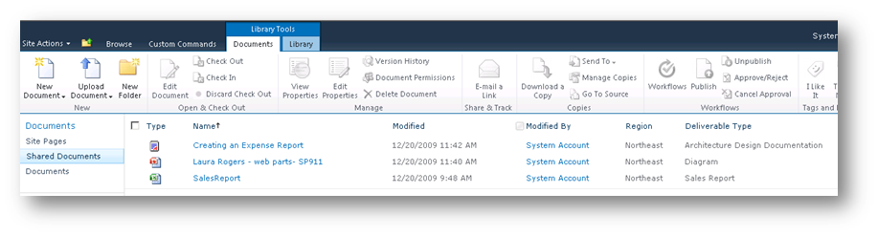
Adding Content
Where is my Upload / New Option?
Selecting list items will activate the ribbon and display the New Options
Notes:
Typically the Tool tabs are organized with the item-level operations on the left and container-level operations on the right. As previously mentioned, the Ribbon is contextual, so operations will enable/disable depending on what the user clicks.
The Ribbon UI also accepts keyboard commands:
Ctrl + ]
Selects the first tab on the active ribbon or selects the last used command on the active ribbon
Ctrl + <one of the 4 way directional arrows>
Navigates the ribbon

Slide 12
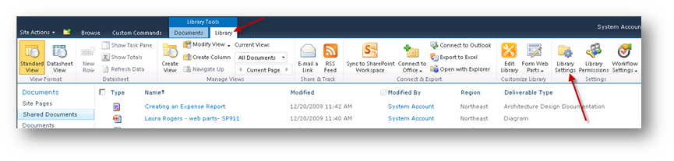
Modifying List Settings
Modify Most Settings Using Ribbon
Note: Additional Ribbon Tabs
Library Settings Option Opens “Classic View”
Configuration options will be based on library type and SKU.

Slide 13
General List Settings
Column | Description
Title, Description & Navigation | Set title, description and Quick Launch.
Versioning Settings | Set versioning settings & required Check Out.
Advanced Settings | Configure: Content Types Default Templates Office Web App Settings Folders Search
Validation Settings | Configure Column Validation criteria and user error message.
Column Default Value Settings | View of all columns & default values. Can modify default values from this screen.
Rating Settings | Enables rating for document libraries.
Audience Targeting Settings | Enable Audience Targeting for list items.
Metadata Navigation Settings | Configures the ability to add filtering navigation based on list metadata.
Per-Location View Settings | Configures views available for each level in the library.
Form Settings | Enables the ability to create custom forms using InfoPath.

Slide 14
Permissions & Communications Settings
Column | Description
Delete | Deletes the document library.
Save as Template | Saves library as template, with or without content.
Permissions | Configured permissions for the library or list.
Managed Checked Out Files | View all checked out files and options take ownership.
Workflow Settings | Configure workflows associated with the list.
Generate File Plan Report | Generates information report for all content within the library.
Information Management Policy Settings | Configure library retention schedules and content type Policies.
RSS | Configures list RSS, including columns to include and item limit.

Slide 15
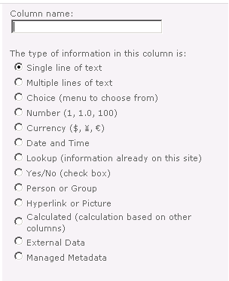
Creating List Columns
Create List Columns to store Metadata
Metadata = “data” about data
Metadata will be used to create List Views
Many different options available for configuring column types
Notes:
New to SharePoint 2010:
Lookup columns have the option to Enforce relationship behavior which gives the option for restricted or cascading deletes to enforce referential integrity.
Column Validation
Allows users via UI to specify a formula which resolves to a boolean value of TRUE.
Can refer to other columns in the list e.g. =[Discount]<[Cost]
Applies to the following column types
Single line of text
Multiple lines of text
Number/Currency
Date and Time
Yes/No
Choice
Calculated

Slide 16
DEMO
Creating Content & Modifying List Settings

Slide 17
Agenda
Understanding the User Interface
Working with Navigation
Working with Lists & Libraries
Working with Views, Pages & Web Parts
Governance

Slide 18
Creating List Views
Views provide a way to easily organize and structure data in meaningful ways.
One set of data can have many different views.
Views can be accessed from the list, or used within web parts on the page.
Notes:
List Views have been completely overhauled in SharePoint 2010. Instead of using CAML (Collaborative Application Markup Language), Microsoft elected to use XSLT to provide a “more coherent platform for defining views of standard SharePoint Foundation list data”.
XsltListViewWebPart replaces the ListViewWebPart object.

Slide 19
Creating List Views
Views can be configured with:
Filtering
Grouping
Inline Editing (ability to modify properties within the view itself)
Styles
Totals
Folders
Mobile Views
Can be customized using InfoPath or SharePoint Designer
Notes:
Ad-Hoc filtering is done by AJAX and XSLT instead of IFrame and CAML technologies in WSS 2007.

Slide 20
Web Parts
The basis of building the user experience
Control that can be added to a page
2 “types” of Web Parts
List view Web Parts – Created when you create new lists.
Functional Web Parts – Web Parts that “do work”, examples – Displaying data from a database, RSS Feeds, Filter Web Parts.
Different SKUs = Different Web Parts
Notes:
To the end user, web parts represents atomic units of functionality they can add to a page. Depending on the particular web part’s implementation, they can be styled, connected to other web parts, or display information from other data sources. The unofficial ‘king’ of web parts in MOSS 2007 Publishing sites was the content aggregator Content Query Web Part (CQWP). Microsoft has listened to developers and improved the CQWP in SharePoint 2010 with features such as display slots which lets users select what fields they want to display from the web part tool pane (Less fighting with XSLT? Yes, please!) as well as PageQueryString & PageFieldValueproperties which let you show different set of results in the CQWP based on a property of the page or a query string.

Slide 21
Pages
Page made up of 2 parts
Master Page
Page layout
Easily Add Text to Pages
Easily Add Web Parts to Pages
Notes:
Master Page: Provides a consistent look & feel across all pages in a site. Master pages are a feature of ASP.NET and not specific to SharePoint. Unlike the previous version of SharePoint, content and application pages now share the same master page. Master pages are stored in the Master Page Gallery at the site collection level.
Page Layout: Template that references a master page which contains web parts and field controls. Page layouts are stored in the Page Layout Gallery at the site collection level.
A lot of investment has been spent in making SharePoint 2010 compliant in Web 2.0 standards– specifically Web Content Accessibility Guidelines (WCAG ) 2.0 compliant. Master Pages have been re-designed with specified CSS-styles and XHTML Strict DocTypes for rendering; making them (more) cross-browser compatible. (Goodbye, tables! Hello, Divs!)

Slide 22
Additional Features
Workflows
Can be configured using browser
Can be customized using SharePoint Designer
Concurrent editing of Office documents
Multiple authors editing the same document live
Opening previously edited Office document gets deltas
Calendar Overlay
Ability to “overlay” up to 10 calendars in one SharePoint view.
Exchange or SharePoint Calendars

Slide 23
DEMO
Creating Pages & Adding Web Parts

Slide 24
Agenda
Understanding the User Interface
Working with Navigation
Working with Lists & Libraries
Working with Views, Pages & Web Parts
Governance

Slide 25
What is Governance?
A set of policies, roles and responsibilities
Designed to let IT and business divisions work together
Designed in accordance with business goals
Benefits to creating a Governance plan
Scalable growth of business content in SharePoint
Consistency in all SharePoint sites across Enterprise
Minimal pain upgrading to a new version of SharePoint
Notes:
Too many organizations have installed SharePoint and thought that it was the magic genie which will fix all their problems. The “pilot” suddenly turns into a production system and as time goes by, users will find interesting ways to ‘solve’ some problem using SharePoint. (e.g. How many times have we heard of the scenario where a user calls up because their SharePoint site is ‘broken’ after they are ‘messing around with SharePoint Designer’.) The SharePoint farm will grow very organically; yielding islands of inconsistent information, branding, and customizations.
A Governance plan one of the most crucial (and often one of the most overlooked) aspects of setting up a SharePoint farm.

Slide 26
Creating a Governance Plans
What should it include?
Information architecture design
SharePoint Hosting plan
Policies for user customization
Strategy for Branding Sites
Plan for End User Training
Notes:
Sounds like a lot of work? Well, it is. But you are saving yourself 10x more work if you ever need to upgrade your farm. Also just as important is the creation of the Governance Plan is the communication of it to end users. This isn’t to say that every single person in your organization needs to fully understand the do’s and don’ts in your company’s SharePoint environment, but the content owners – be it site collection or site owners need to understand and be aware of any changes.
Don’t know who your content owners are? Or who a site was created for? SharePoint Foundation has some nice events such as WebAdding or WebProvisioned that you can extend to help with that.

Slide 27
Discussion
Does Your Company Need a Governance Plan?

Slide 28
Summary
Understanding the User Interface
Working with Navigation
Working with Lists & Libraries
Working with Views, Pages & Web Parts
Governance

